Slide 1
Fetal Cardiotocograph (CTG) Classification
Kate Stadelman

Slide 2
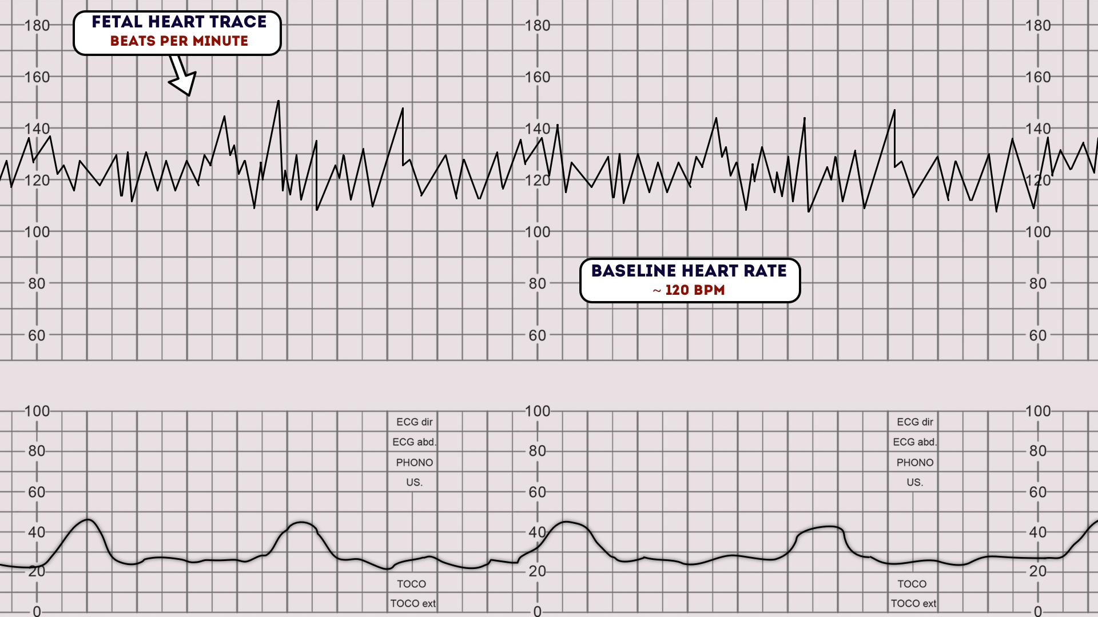
Cardiotocographs (CTGs)
How to Read a CTG
Monitor fetal heart rate & uterine contractions
Cost-effective way to help reduce fetal mortality

Slide 3


CTG Pros & Cons
Detect fetal compromise
Allow mothers to seek early treatment
Require specific training for interpretation
Same test interpreted differently based on reviewer

Slide 4
Research Question
How do Random Forest, Logistic Regression,
and K-Nearest Neighbors compare in
predicting a normal vs. abnormal CTG
given test metrics?

Slide 5
CTG Dataset
2,126 CTG Records ❖ 21 Numeric Input Features
Numeric Input Feature Categories
Uterine Contractions
Fetal Movements
Fetal Heart Rate (FHR) Baseline
FHR Accelerations & Decelerations
FHR Short- & Long-Term Variability
FHR Histogram Descriptive Statistics
Output Class Labels
Normal (Class 0)
Abnormal (Class 1)
CTG reading classification by three expert obstetricians

Slide 6
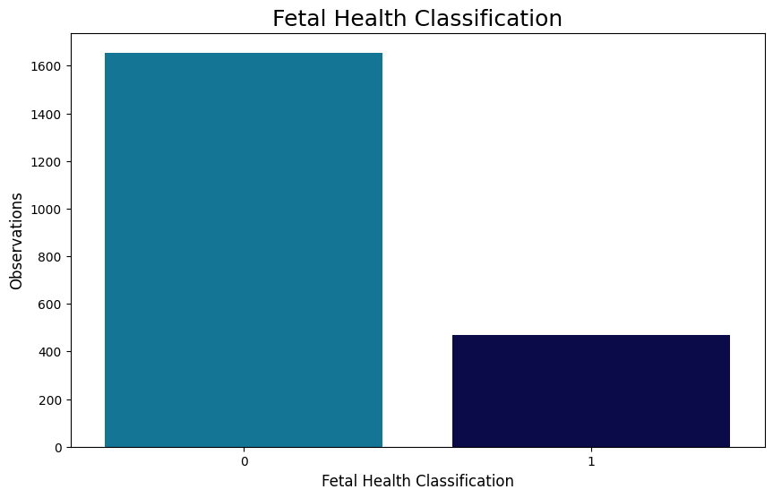
Exploratory Data Analysis
Imbalanced Output Classes
False Negatives are more harmful than False Positives
ROC Area Under Curve & Recall are better measures than Accuracy

Slide 7
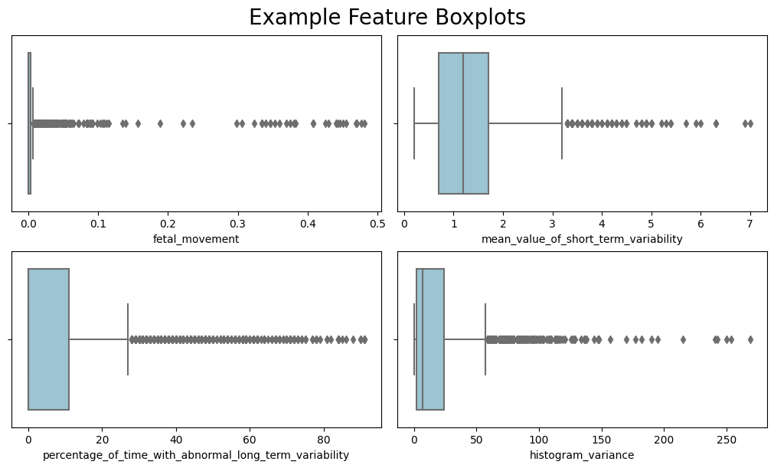
Exploratory Data Analysis
No missing values
Several features with many outliers
Outliers removed
Below Q1 – 1.5 × IQR
Above Q3 +1.5 × IQR

Slide 8
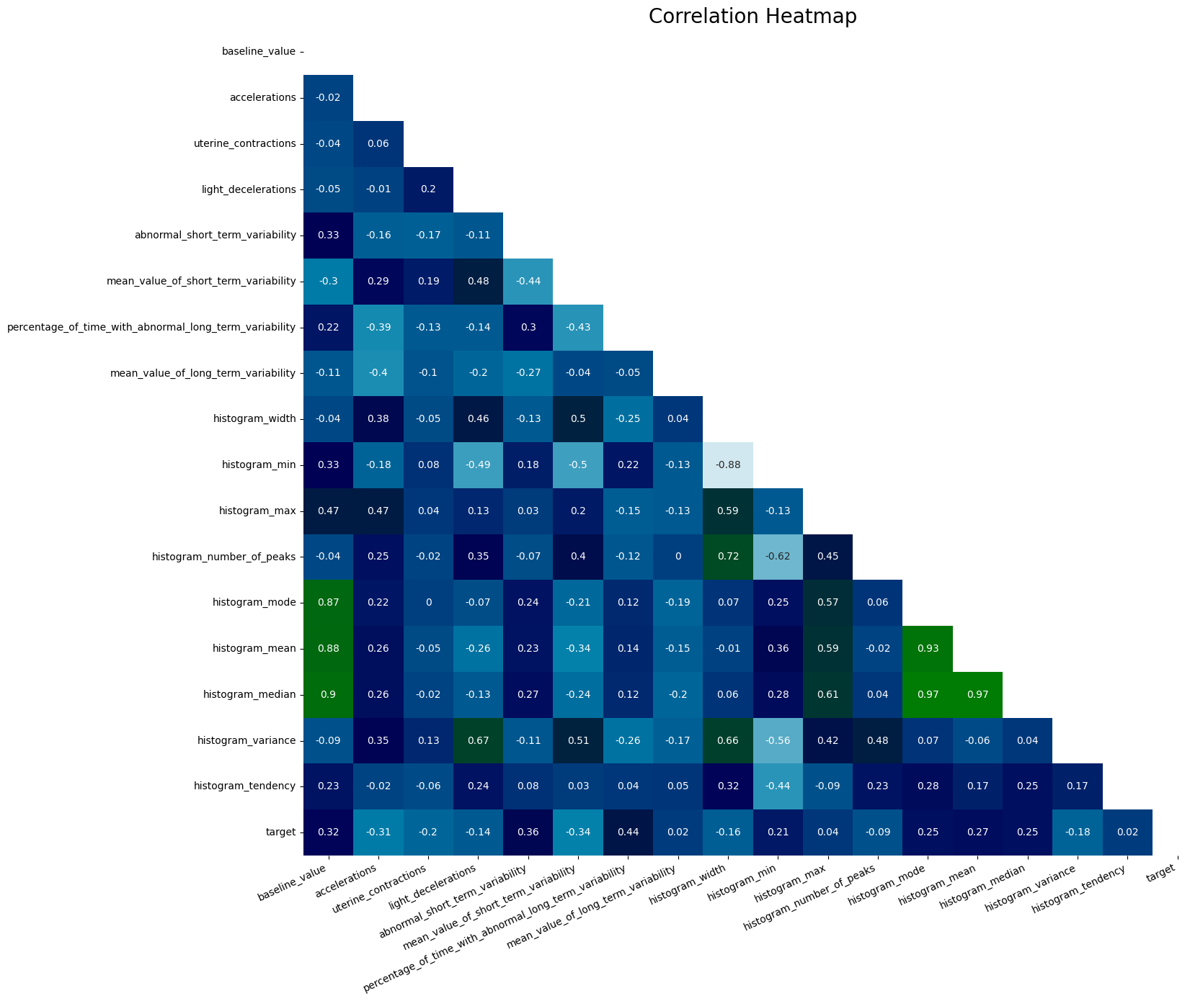
Exploratory Data Analysis
Highly correlated features
Principal Component Analysis used to extract seven features
Cumulative explained variance: 99.2%

Slide 9
Data Scaling & Splitting
Min-max normalization used to maintain original variance
Observations randomly split between Train (70%) and Test (30%)

Slide 10
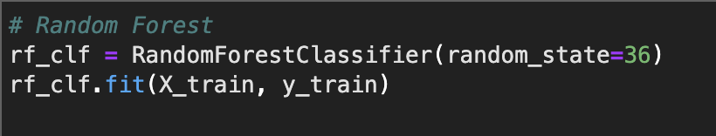
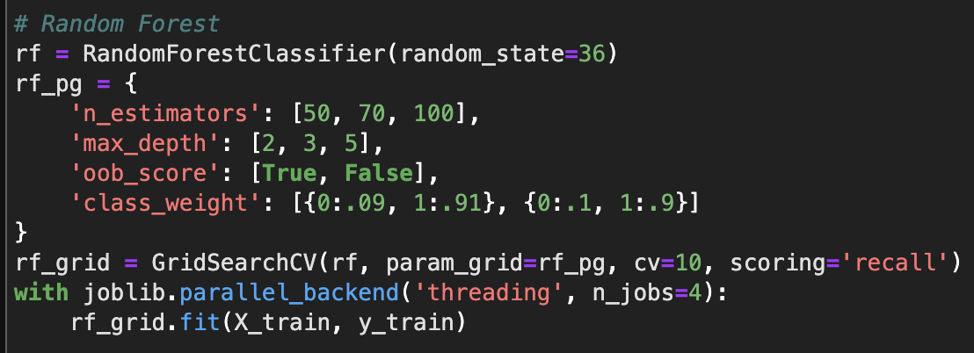
Model Building & Optimization
Random Forest
Initial model is overfitted
Poor Recall & F1-Scores, likely due to output class imbalance
Baseline Model Scores
Dataset | Accuracy | ROC AUC | Recall | F1-Score
Train | 1.000 | 1.000 | 1.000 | 1.000
Test | 0.948 | 0.880 | 0.796 | 0.677

Slide 11
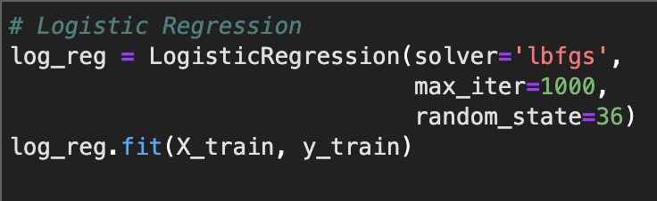
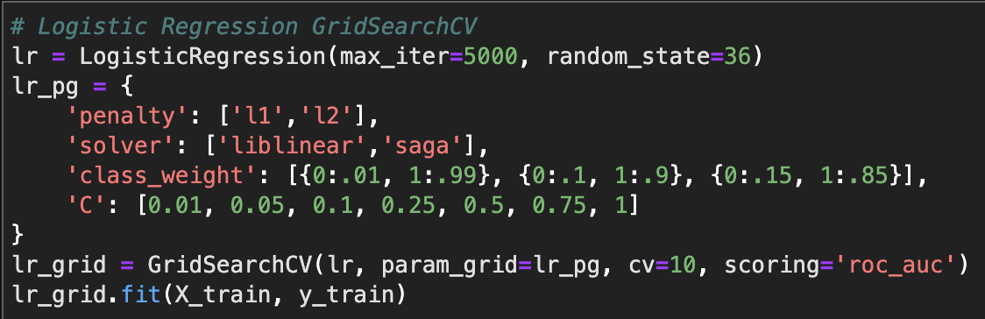
Model Building & Optimization
Logistic Regression
Poor Recall & F1-Scores, likely due to output class imbalance
Baseline Model Scores
Dataset | Accuracy | ROC AUC | Recall | F1-Score
Train | 0.912 | 0.699 | 0.427 | 0.515
Test | 0.928 | 0.723 | 0.472 | 0.540

Slide 12
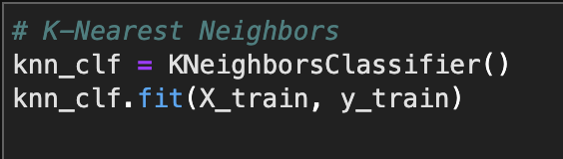
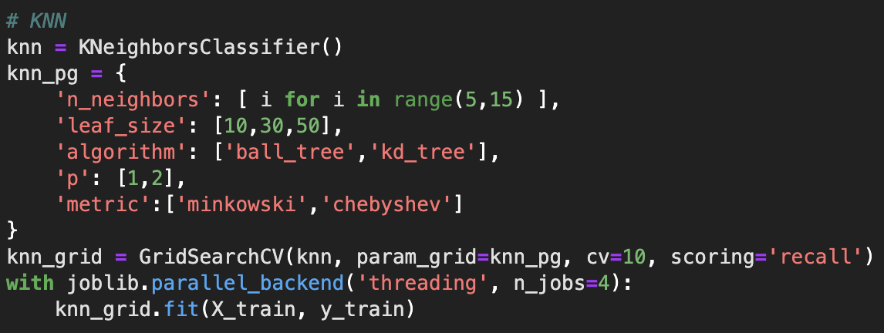
Model Building & Optimization
K-Nearest Neighbors
Poor Recall & F1-Scores, likely due to output class imbalance
Baseline Model Scores
Dataset | Accuracy | ROC AUC | Recall | F1-Score
Train | 0.932 | 0.762 | 0.544 | 0.636
Test | 0.926 | 0.734 | 0.500 | 0.734

Slide 13
Model Comparison
Training Data Final Scores
Model | Accuracy | ROC AUC | Recall | F1-Score
Random Forest | 0.854 | 0.895 | 0.944 | 0.535
Logistic Regression | 0.877 | 0.882 | 0.889 | 0.561
K-Nearest Neighbors | 0.931 | 0.711 | 0.444 | 0.533
False Negatives are more harmful than False Positives
ROC AUC & Recall are most relevant metrics
Random Forest outperforms other models
Initial overfitting resolved by hyperparameter tuning
Test Data Final Scores
Model | Accuracy | ROC AUC | Recall | F1-Score
Random Forest | 0.854 | 0.895 | 0.944 | 0.535
Logistic Regression | 0.877 | 0.882 | 0.889 | 0.561
K-Nearest Neighbors | 0.931 | 0.711 | 0.444 | 0.533

Slide 14
Discussion & Lessons Learned
Random Forest is the best model with the highest ROC AUC and Recall.
Test ROC AUC: 89.5%
Test Recall: 94.4%
Most influential variables in determining a Normal vs. Abnormal CTG:
FHR Histogram Mode
FHR Abnormal Short-Term Variability
FHR Percentage of Time with Abnormal Long-Term Variability
Recommend increasing sample size in future research due to large number of outliers.

Slide 15
References
Ayres-de-Campos, D., Bernardes, J., Garrido, A., Marques-de-Sá, J., & Pereira-Leite, L. (2000). SisPorto 2.0: A Program for Automated Analysis of Cardiotocograms. The Journal of Maternal-Fetal Medicine. 9(5), 311-318. https://doi.org/10.1002/1520-6661(200009/10)9:5%3C311::AID-MFM12%3E3.0.CO;2-9
Potter, L. (2021, November 12). How to Read a CTG. Geeky Medics. https://geekymedics.com/how-to-read-a-ctg/
Prior, L, & Lees, C. (2019). Control and Monitoring of Fetal Growth. Encyclopedia of Endocrine Diseases (Second Edition). https://www.sciencedirect.com/topics/nursing-and-health-professions/cardiotocograph

